Slide 1



Waste Cost Prediction Model
The primary aim of this project is to develop a predictive model to estimate the waste cost.
This model will assist in optimizing waste management processes, reducing costs, and improving overall efficiency within the plate production process.

Slide 2
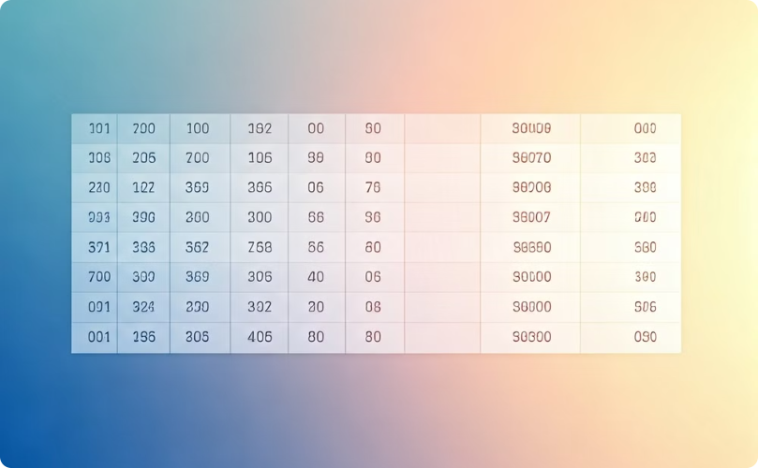

DATASETS
Batch Data
Fail Data
Represents various stages and parameters involved in the plate production process.
Pertains to batches that did not pass quality control (QC) testing.

Slide 3
Exploratory Data Analysis and Visualization
Exploratory data analysis (EDA) is crucial for understanding the data and identifying patterns, trends, and outliers.
Visualizations help in gaining insights and communicating findings effectively.
1
Data Distribution
Analyze the distribution of variables.
2
Correlation Analysis
Identify relationships between variables.
3
Outlier Detection
Identify and handle outliers.
4
Feature Importance
Determine the importance of features.
EDA helps in understanding the data and identifying potential issues.

Slide 4




Model Development
The model development process involves several key steps, including data splitting, feature selection, model training, evaluation, and iteration.
A stacking regressor with four base models - RandomForest, GradientBoosting, XGBoost, and LightGBM - was used to optimize the predictive performance. Additionally, an MLPRegressor (Multi-Layer Perceptron Regressor) was employed as a metamodel to further enhance the model's accuracy
The stacking regressor combines the predictions of the four base models, leveraging their unique strengths and characteristics to create a more robust and accurate predictive model.
The MLPRegressor, as the metamodel, then learns from the predictions of the base models to provide the final, optimized output.
This comprehensive approach to model development ensures that the waste cost prediction model is as accurate and reliable as possible, enabling better decision-making and process optimization within the plate production process.

Slide 5



Model Evaluation Results and Interpretation
MSE
1
Average squared difference between predicted and actual values
2
R-squared
Proportion of variance explained by the model
Cross-Validation
3
Robust evaluation using multiple training and validation sets
MSE of 2.4017 indicates that the model's predictions deviate from the actual values by a squared difference of about 2.4017 units on average.
The R2 score of 0.219 suggests that approximately 21.9% of the variance in the target variable (Waste Total Cost) is explained by the model.
The cross-validation results show high variability in the R2 scores across different folds.
The mean CV R2 score of 0.7775 suggests that, on average, the model explains about 77.75% of the variance in the target variable during cross-validation.

Slide 6
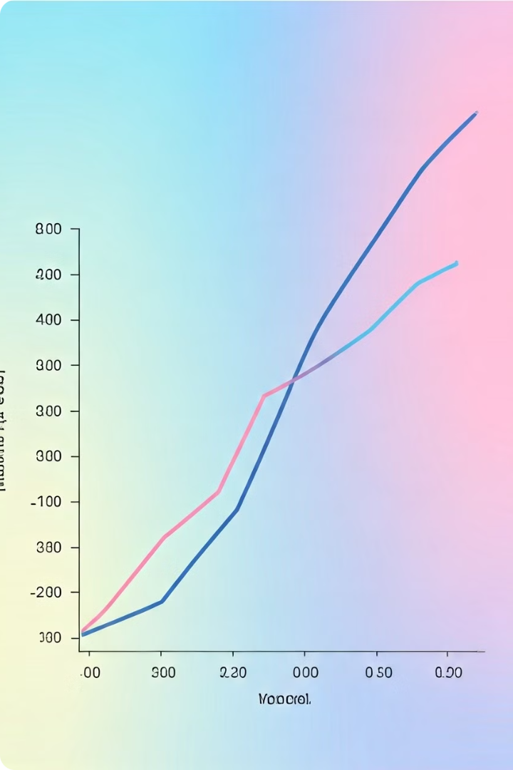
Model Evaluation Results and Interpretation
1
Outlier Removal
Original Data Shape: (2171, 44)
Cleaned Data Shape: (2147, 44)
2
Model Retraining
Stacking Regressor Retrained
Model Re-evaluated
3
Evaluation Metrics
Mean Squared Error (MSE): 0.003661195394590265
R-squared (R2): 0.9658258023263161

Slide 7

Conclusion
Key Insights: The results after outlier removal and cross-validation demonstrate a significant improvement in the model's performance.
The model is now more accurate and reliable, with the ability to generalize well to new data.
The model's generalization capability is validated through consistent high cross-validation R2 scores, indicating reliable performance across different subsets of the data. The use of LIME for interpretability provides valuable insights into the feature contributions, ensuring transparency and aiding in the understanding of the model's decision-making process. Overall, the model not only predicts Waste Total Cost with high accuracy but also offers interpretable insights, making it a valuable tool for optimizing production processes and minimizing waste costs in a manufacturing context.

